Slide 1
Experimenting with OpenAI

Slide 2
What’s this about?
Getting started
How does this work?
ChatGPT
Streamlit
Additional Params
What can I do with all this?
Outro

Slide 3
Getting started
Clone the repo: psychonout/chatgpt-presentation (github.com)
Visit https://platform.openai.com/account/billing/overview
Set-up a payment method
Generate an authentication token at https://platform.openai.com/api-keys
Make sure to set-it in your own project’s .env
Install the packages
Start bott(l)ing

Slide 4
How does this work?

Slide 5
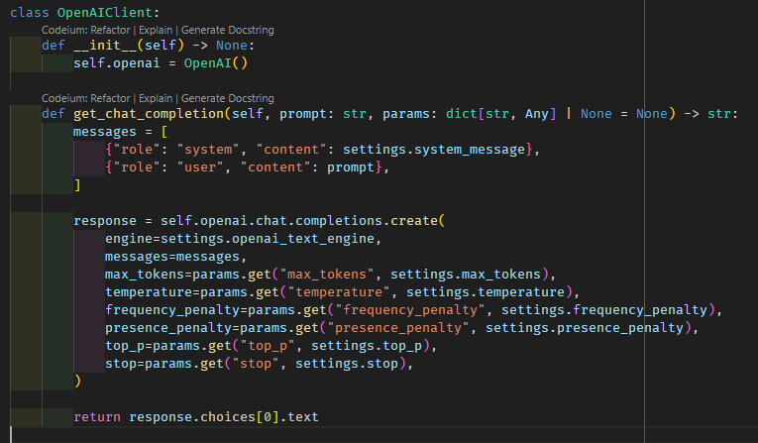
ChatGPT
The devil is in the details
A.k.a. system message
In the example repo
the chatbot is told
To be a helpful wingman
But is it?
Some repos for inspiration
Github-link-number-1
Github-link-number-2
Github-link-number-3

Slide 6
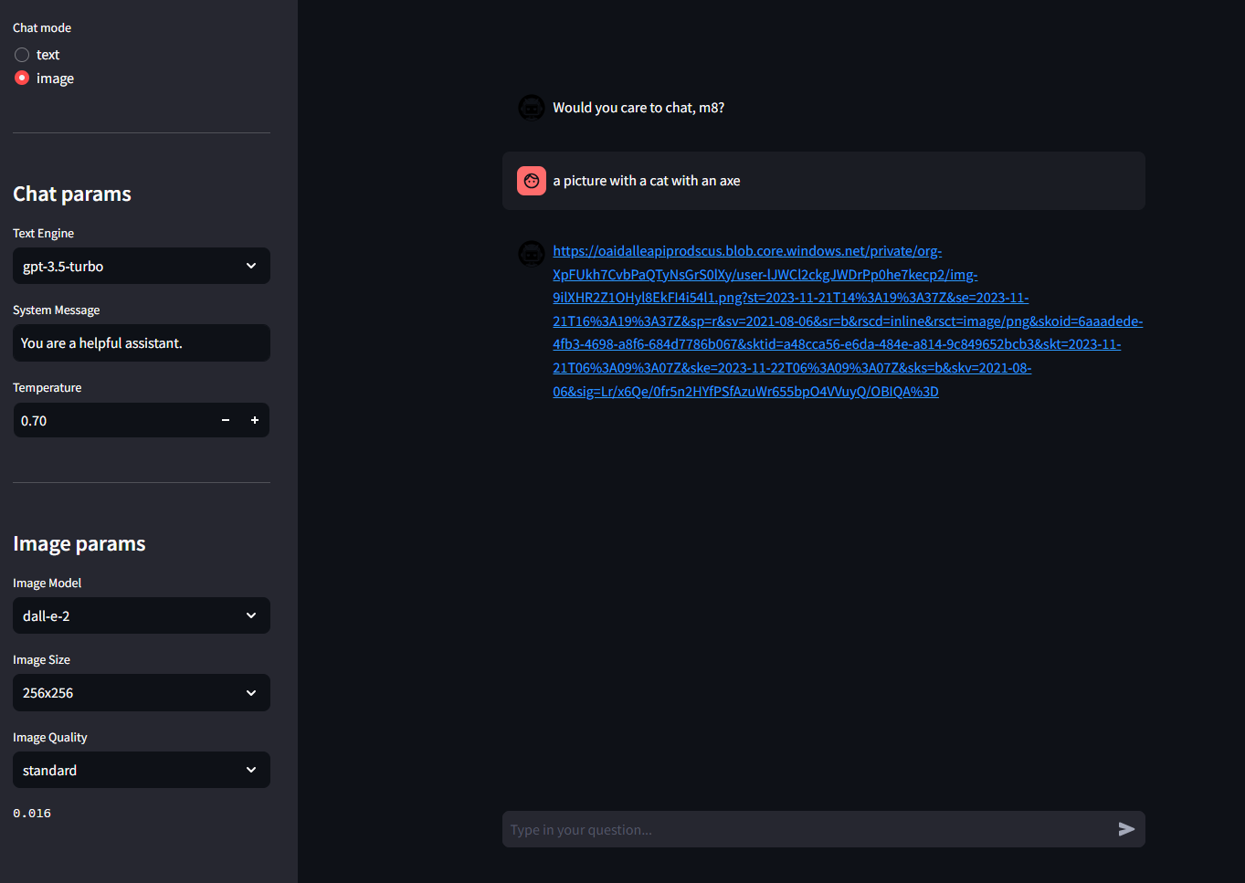
Streamlit
Self-explanatory interface
Additional params can be set in sidebar
Has been improved to display pictures directly in chat (hopefully)

Slide 7
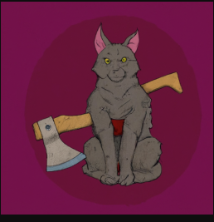
In case you were wondering how does the cat with an axe look

Slide 8



Additional images generated later

Slide 9
Additional notes
Earlier screenshots already outdated
The repo only allows to set the most important parameters for text and chat
The text generations can be improved by you to accept additional parameters, which are all explained in documentation https://platform.openai.com/docs/guides/text-generation/parameter-details
Additional info on token calculation: https://help.openai.com/en/articles/4936856-what-are-tokens-and-how-to-count-them
Tokenizer repo: https://github.com/openai/tiktoken
Image parameters are self-explanatory
The image quality does increase the price
We therefore show the price of a generated image below the parameters
Max price is currently $0.12 / image and is probably better utilized using Bing Chat

Slide 10
What can I do with all this?
Anything - sky's the limit
Do share if you find any fun use-cases
Check out their very good documentation: https://platform.openai.com/docs/overview

Slide 11
Outro
Easy to start using
System messages are important
Careful with billing settings (auto charge is dangerous)
Thank you
Questions?
Demo time
Using this layout because it’s the prettiest

